Slide 1


Phone Buying Behavior Analysis in Myanmar
Empirical Churn Drivers, Customer Segmentation & Predictive Mining
Course Code IS-212
Presented By Ma Khin Than Thar
Date September 2026

Slide 2












Presentation Agenda
Introduction & Market Objectives
Data Collection & Preprocessing
Demographics & Budget Distribution
Priority Analysis by Gender
Brand Switching & Churn Analysis
Customer Segments (K-Means)
Association Rule Mining
Predictive Model Results
Recommendations & Conclusion

Slide 3

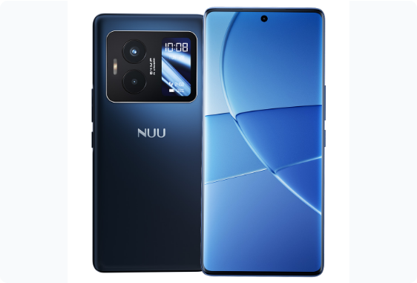
Executive Summary & Overview
Dynamic Market: Highly competitive landscape dominated by Apple, Samsung, Redmi, Vivo, and Xiaomi.
High Churn Rate: 73% of surveyed respondents have actively switched phone brands.
Core Objective: Understand WHY consumers switch brands and build a machine learning model to PREDICT churn.
Dataset: 550 empirical survey responses collected from university students across Myanmar.

Slide 4
Data Collection & Preprocessing
Feature Domain | Collected Data Fields | Preprocessing & Transformation
Demographics | Age, Gender | Cleaned range outliers; mapped age brackets
Brand Usage | Current Brand, Previous Brand | Created brand switching status matrix
Economics | Budget (Lakhs MMK) | Normalized numeric scale (Range: 10 - 50L)
Behavioral Scores | Loyalty, AI Interest, After-Sales (1-5) | Standardized ordinal scoring metrics
Top Priorities | Camera, Battery, Gaming, SOC, Brand | Challenge: Comma-separated strings Solution: Binary One-Hot Encoding

Slide 5
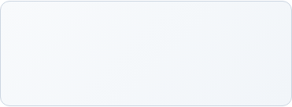
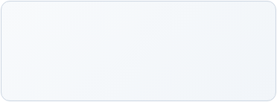
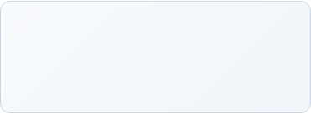
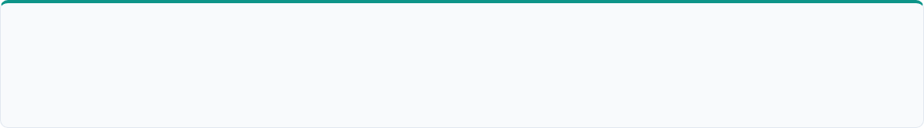
Demographics & Budget Metrics
23 Yrs
16 Lakhs
10 Lakhs
Average Respondent Age
Average Budget (MMK)
Most Common Budget
Key Demographic Insights
• Age Distribution: Spans 19 to 54 years, heavily concentrated among university students (19–25 years).
• Price Sensitivity: University students exhibit strong budget awareness, making the 10–16 Lakhs MMK tier the most competitive battleground for smartphone manufacturers.

Slide 6
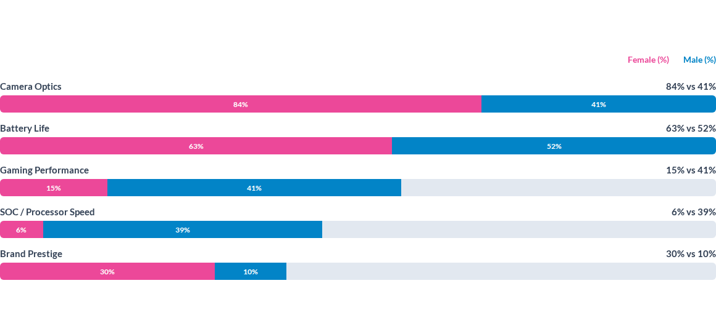
Key Priorities by Gender

Slide 7
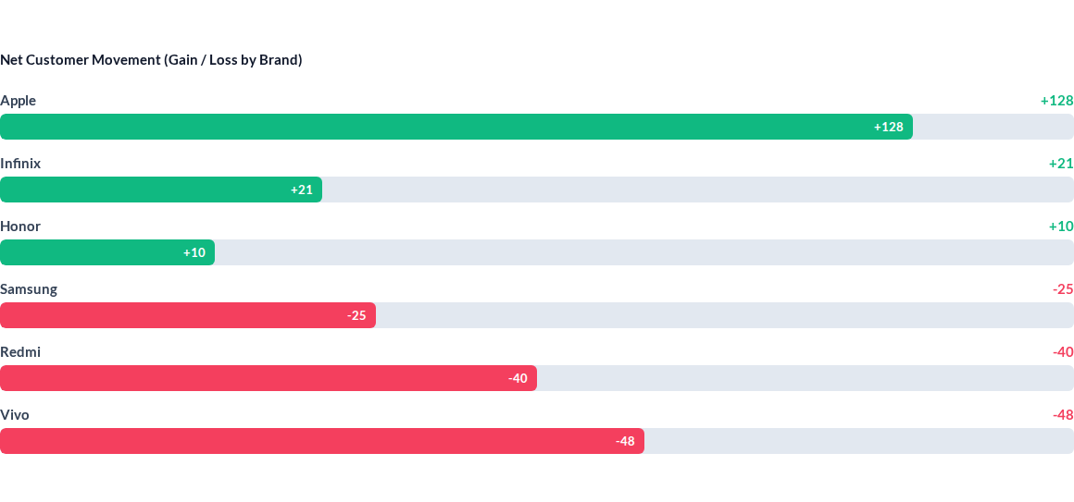
Brand Switching Dynamics

Slide 8


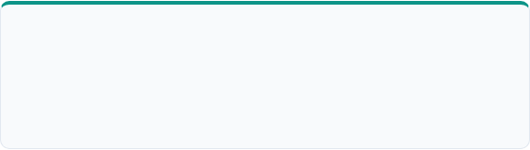

Customer Segmentation (K-Means)
Cluster 0: Feature Enthusiasts
Cluster 1: Premium Power Users
Share: 39% (215 users) | Avg Age: 22
Share: 28% (155 users) | Avg Age: 24
Budget: 15.8L MMK | Traits: High AI feature demand, seeks maximum tech specifications.
Budget: 21.3L MMK | Traits: Highest budget, brand loyal (4.57/5 loyalty score).
Cluster 2: Senior Traditionalists
Cluster 3: Budget Hunters
Share: 28% (155 users) | Avg Age: 31
Share: 4.5% (25 users) | Avg Age: 44.6
Budget: 12.2L MMK | Traits: Low AI interest, values utility and battery longevity.
Budget: 9.8L MMK | Traits: Lowest price ceiling, highly value-conscious mindset.

Slide 9
Association Rule Mining
Frequent priority combinations discovered using the Apriori Algorithm:
Rule Antecedent (If) | Consequent (Then) | Support | Confidence | Lift
{Affordability, Camera} | {Battery} | 10.18% | 75.68% | 1.27x
{Brand Reputation} | {Camera} | 12.40% | 79.85% | 1.11x
{Affordability} | {Battery} | 18.50% | 70.75% | 1.18x
{Gaming, Processor} | {Battery} | 8.90% | 68.40% | 1.22x

Slide 10
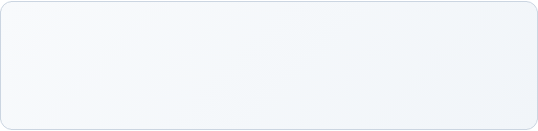
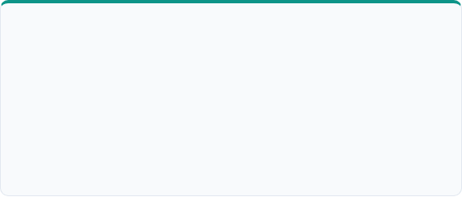
Predictive Model Metrics
91.5%
Confusion Matrix
Model Accuracy (Gradient Boosting)
Actual / Pred | Pred: Stayed | Pred: Switched
Actual: Stayed | 40 (TN) | 5 (FP)
Actual: Switched | 9 (FN) | 111 (TP)
Precision: 0.96 (High fidelity in predicting switchers)
Recall: 0.93 (Captures 93% of true churn cases)
F1-Score: 0.94 (Optimal balance)

Slide 11
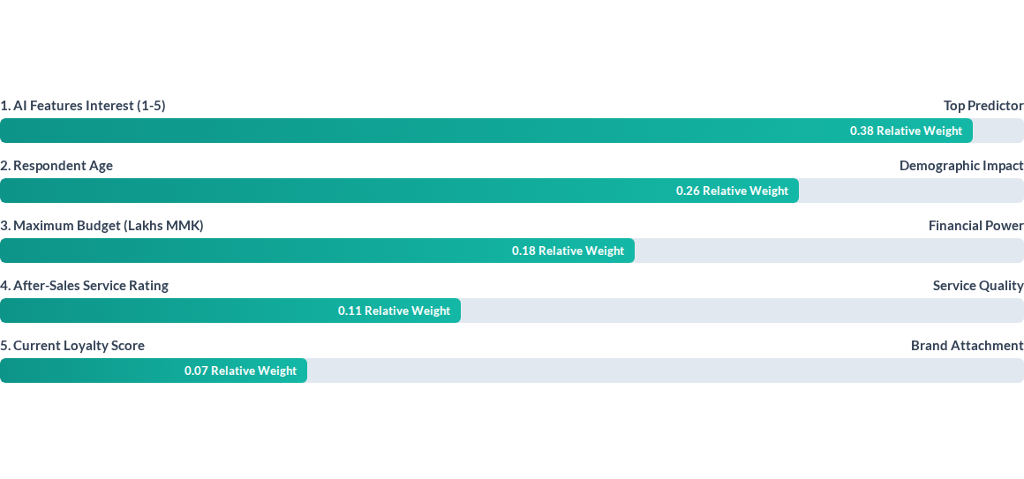
Key Drivers of Brand Switching

Slide 12
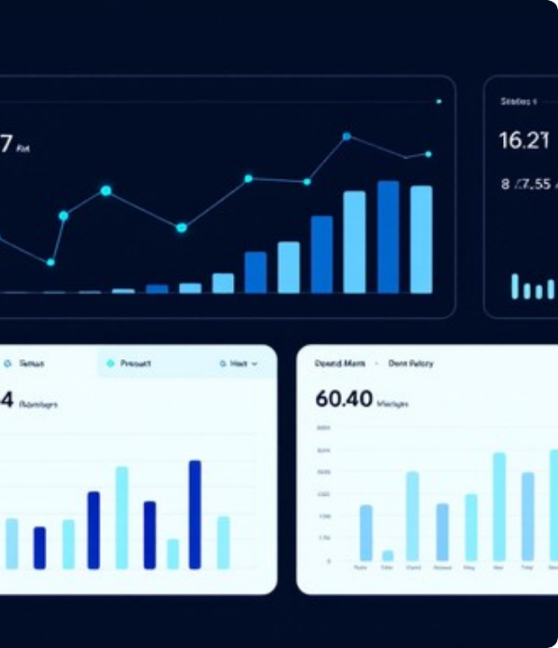
Interactive Analytics Dashboard
Streamlit Web App: Real-time exploration of Myanmar student dataset.
7 Modules: Overview, Brand Gain/Loss, K-Means Clustering, Rule Mining, Churn Predictor, Explorer, & Strategic Insights.
Interactive Tools: Test custom customer profiles dynamically to evaluate churn probability.

Slide 13
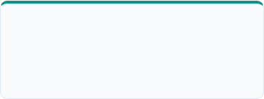
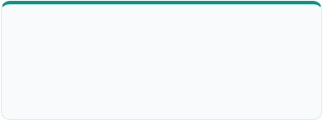
Live Dashboard Features
Dynamic Filters
Brand Matrix
Real-time Predictor
Filter entire survey cohort by brand, age bracket, and budget ceiling dynamically.
Analyze brand-to-brand transition flows and customer migration metrics.
Input individual customer parameters to predict churn risk instantaneously.

Slide 14
Strategic Business Recommendations
Camera + Battery Bundles: Focus marketing on budget models offering strong battery performance paired with high-spec camera optics.
Youth Loyalty Programs: Target university students (19–25 age group) early to capture brand loyalty prior to budget expansion.
AI Capability Acceleration: Enhance on-device AI features in mid-range devices to counter market share loss to Apple.
After-Sales Support Expansion: Upgrade regional repair hubs to boost retention among high-value customer clusters.

Slide 15

Thank You!
Phone Buying Behavior Analysis in Myanmar
Presenter:
Course:
Questions & Discussion Welcome

Slide 16


Image Sources
https://nuumobile.com/wp-content/uploads/2025/10/b40-android-phone-front-back.jpg
Source: nuumobile.com
https://images.stockcake.com/public/c/9/a/c9a7a5e8-a217-445c-bdf0-e740903f156c_large/modern-data-dashboard-stockcake.jpg
Source: stockcake.com

